Slide 1
Six Guys Hackathon
By 6 Guys
22/08/2024

Slide 2
Task 1

Slide 3
TVM

Slide 4
Task 2

Slide 5
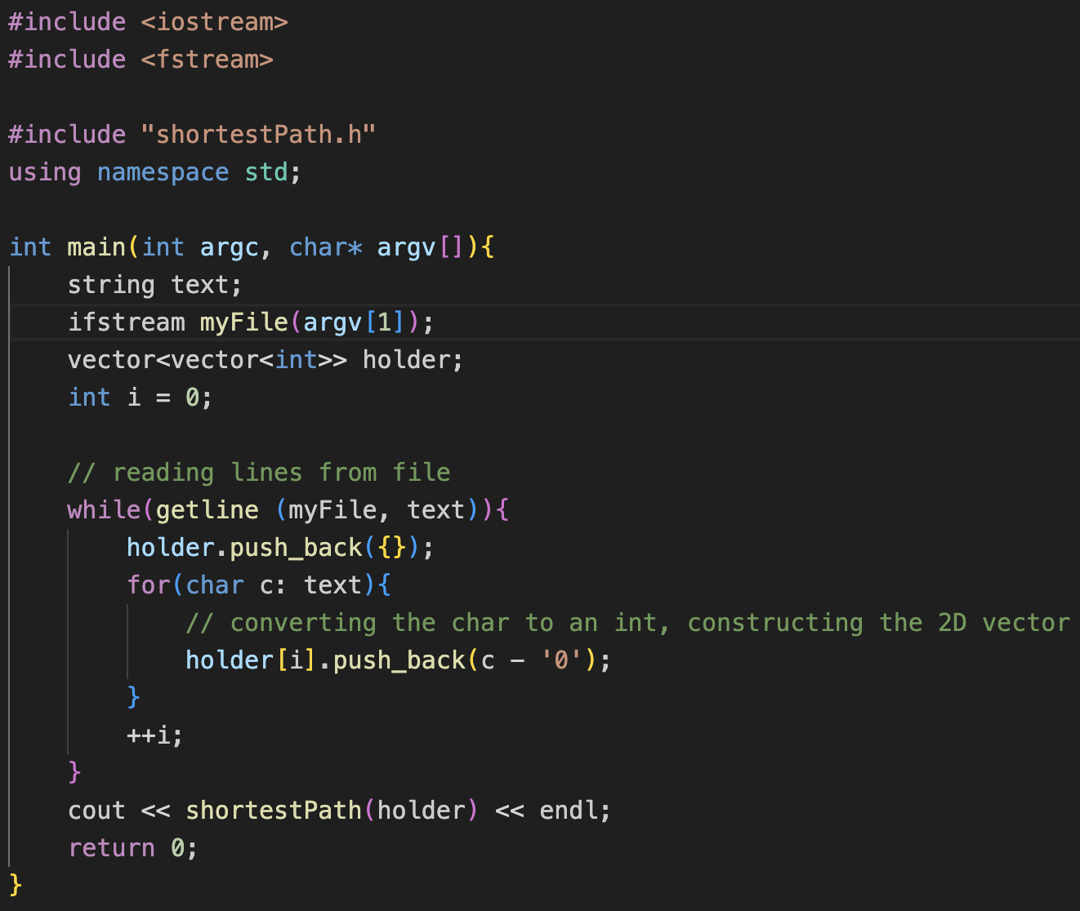
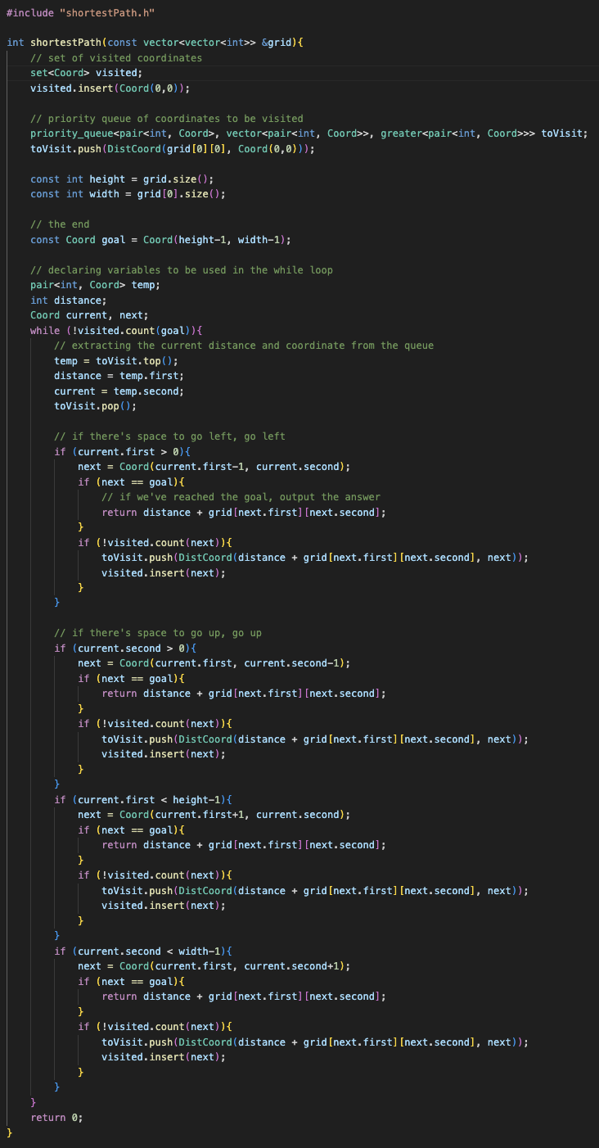
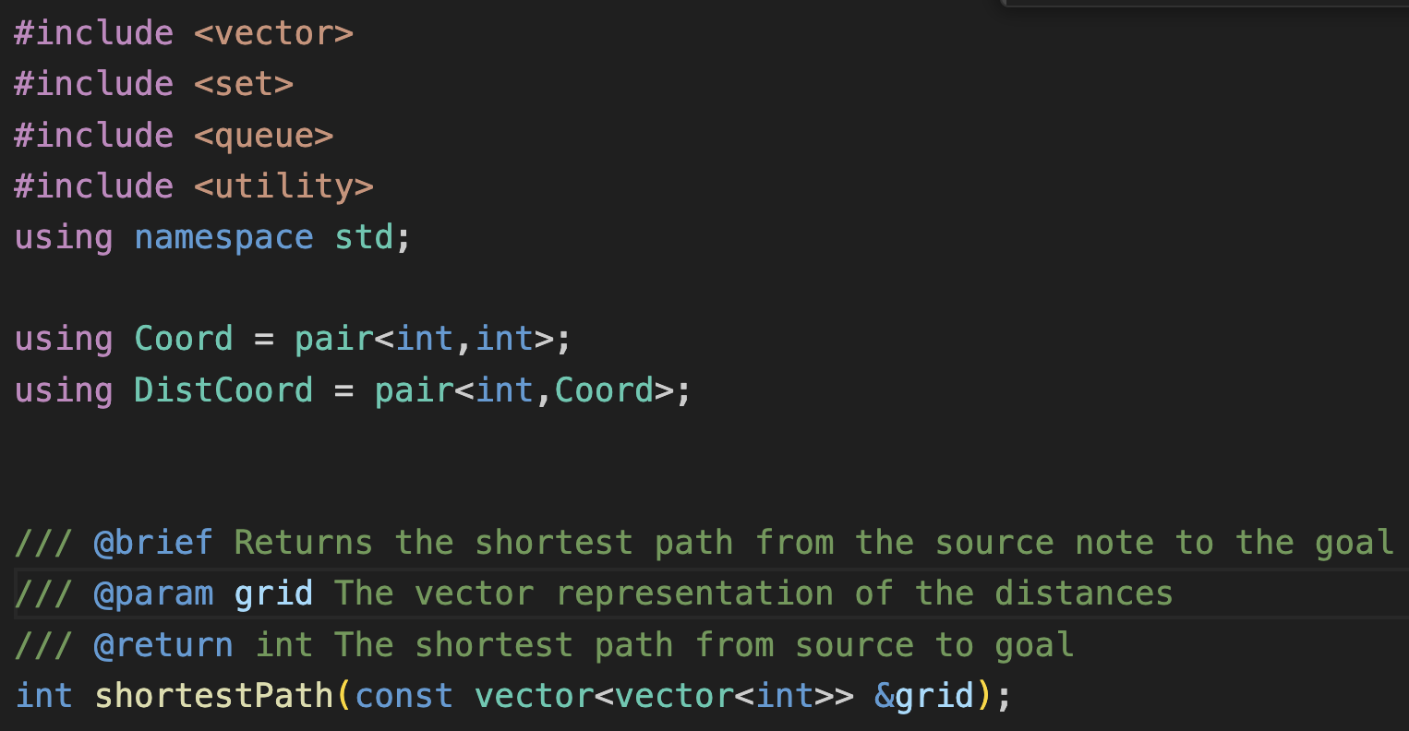
Task 2

Slide 6
Benchmarking

Slide 7
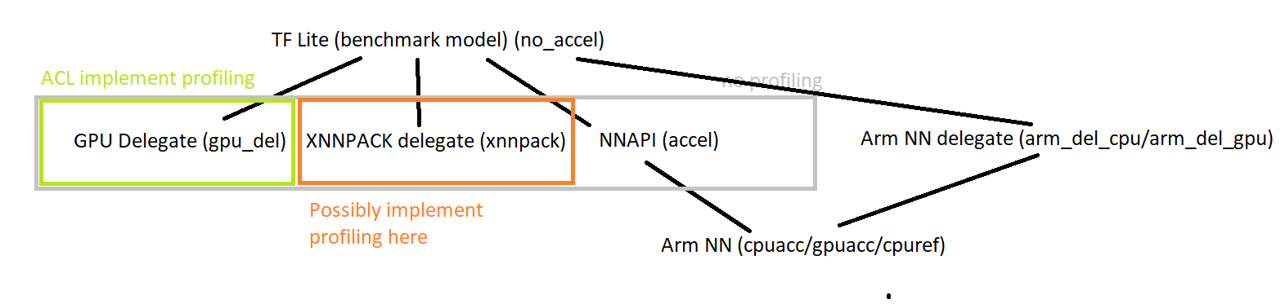
Benchmark ML SW – TF Lite backends
Higher
Same numbers used for flow identification
1
2
4
8

Slide 8
Benchmarking via CI system (Jenkins)

Slide 9
Benchmark ML SW – 4 & 5
NN API + Arm NN (AndroidNN)
Find an available device : https://engsys1.ml.arm.com/lockable-resources/
oneplus8-pro-remote-88718767
Running in Jenkins:
cd benchmark-ck
vscode .
Modify ck-ivg-bench/script/workload-scripts/core/standalone/JenkinsRun
jbp.slack_targets = ['@stuart.taylor']
job = 'TFLite'
jbp.workload_scripts = ['tensorflow.lite.WorkloadsNightly']
jbp.build_job_name = '/armnn/devenv/builds/armnn.devenv.NightlyBuild'
jbp.android_devices = ['oneplus8-pro-remote-88718767']
jbp.extra_cmd_args = '--tf_versions v2.2.0 --tf_programs label --compute cpuacc -c2 3xG585_max -n tflitemodel-efficientnet_b0-int8-armzoo -p int8'
python3 -m core.standalone.JenkinsRun
5
For profiling add: --profiling
cpuacc: AnrdoiNN + ArmNN cpu
gpuacc: AnrdoiNN + ArmNN gpu

Slide 10
Task 3- StockIt

Slide 11
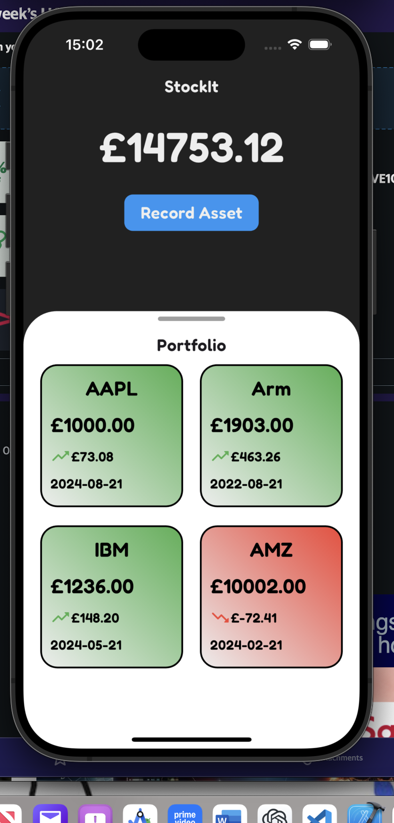
StockIt App
Calculations:
Number of Shares = Money Invested/Old Share Price
New Value = New Share Price * Number of Shares
P/L = New Value - Money Invested

